Slide 1

Deep Learning Models: Online Host, Visualization and Deployment
Presented By:
Rahul Dhamerla,7
Teja Devarapalli,5
Gopi Chand Bodepudi,2
Vasudev Madala,16

Slide 2
Motivation
With the advances in deep learning applications, sharing the trained models online becomes a critical component of the overall deep learning lifecycle. Currently, trained models are share on private websites or dumped into storage services like GitHub, which cannot visualize the model and its metadata, test it online, or deploy it online.

Slide 3
Project Goal/Objective
Our idea was to develop a web application similar to GitHub for users to host trained models and provide access with everyone to download and can like or comment accordingly.

Slide 4
System Features
User Dashboard
Upload
Download
Search
View
Like
Delete
Comment

Slide 5
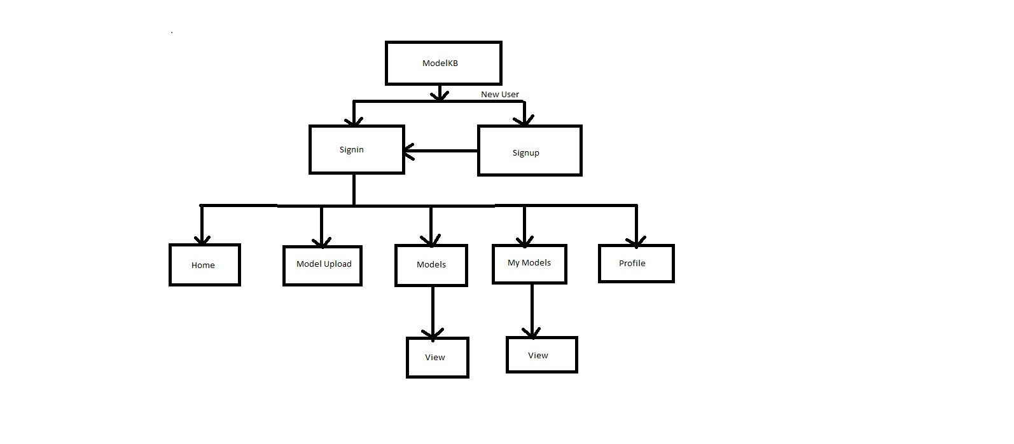
System Flow

Slide 6
Technologies/Applications
Mongo DB
Express JS
Angular
Node JS
HTML5,CSS3,Bootstrap
WebStorm

Slide 7
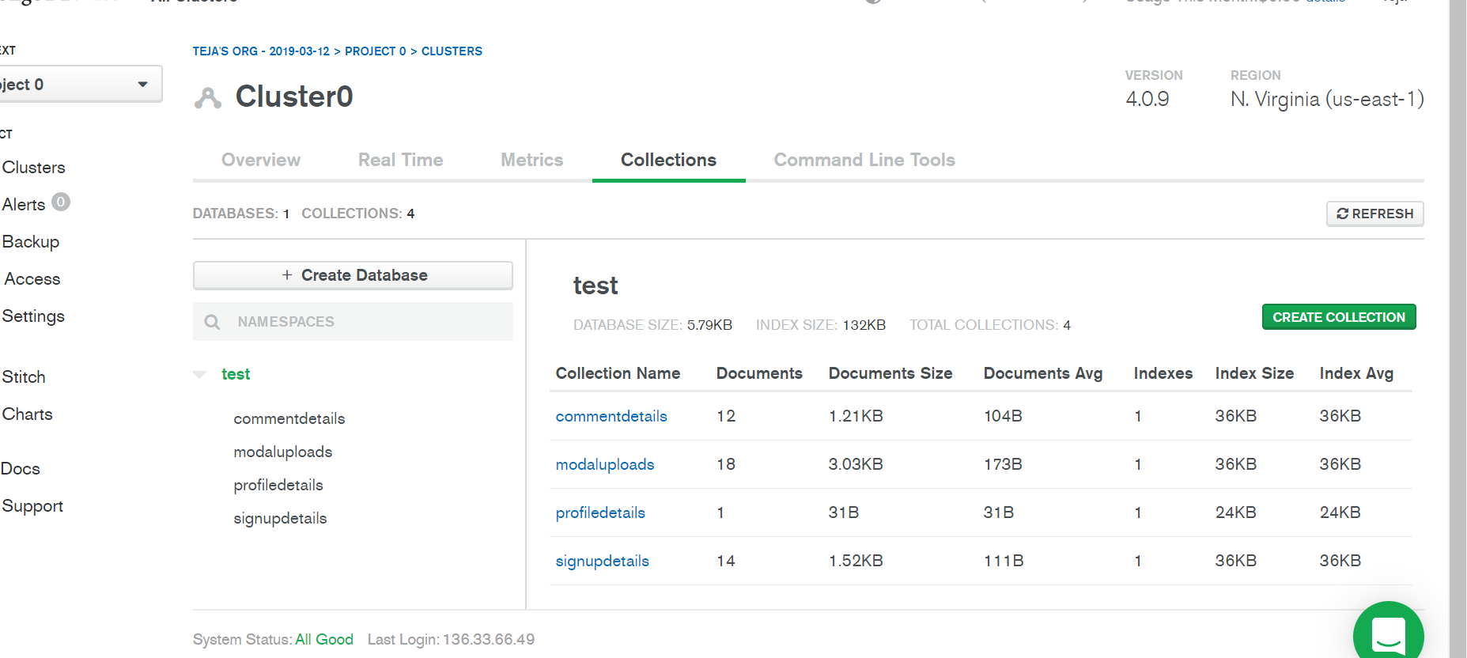
Mongo DB Collections

Slide 8
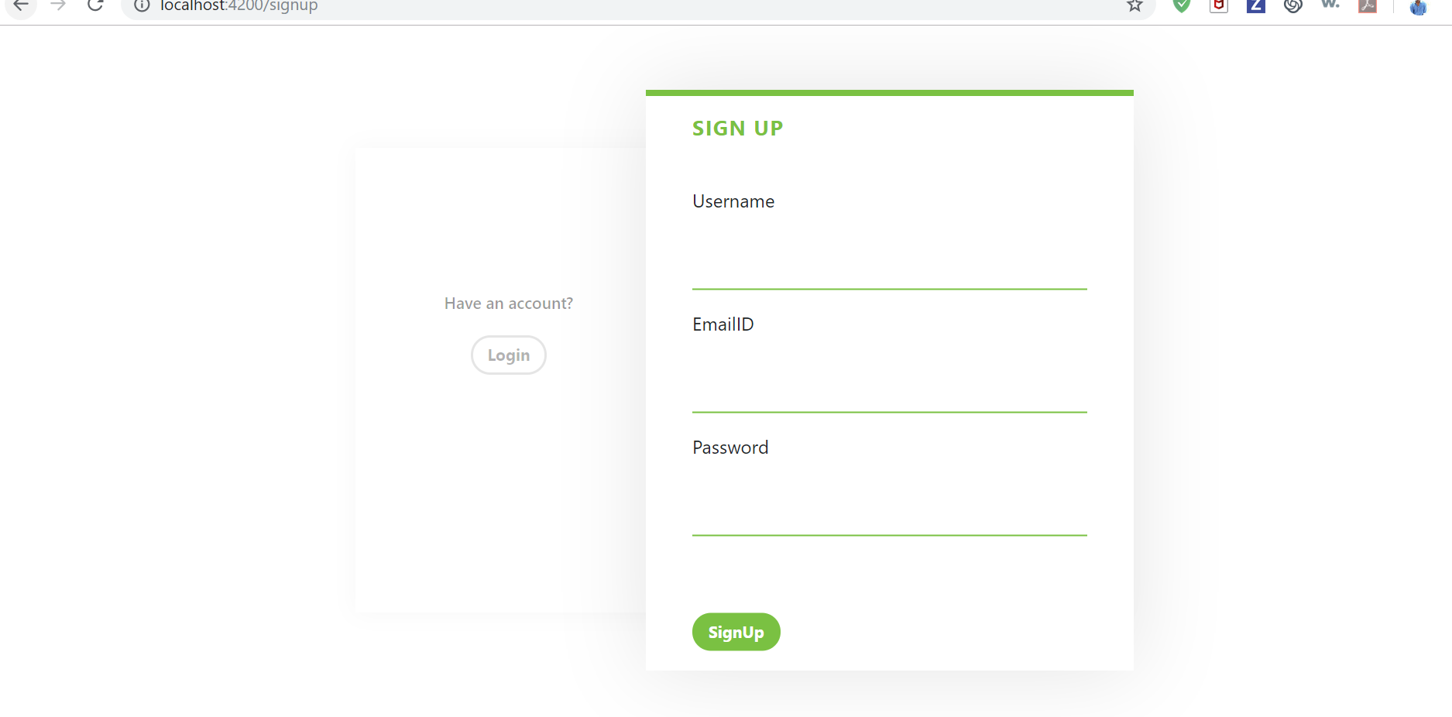
Screenshots : Sign UP

Slide 9
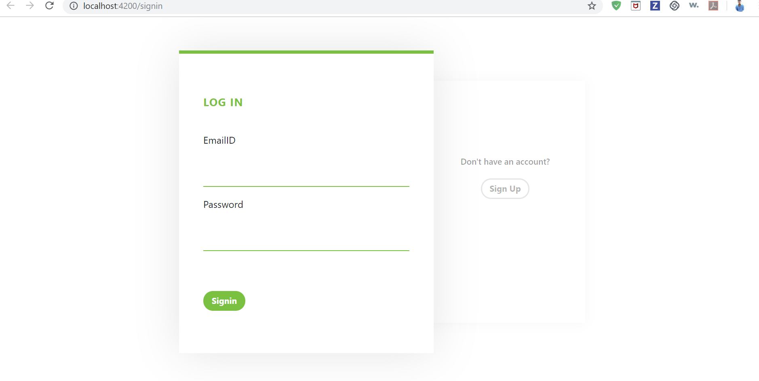
Sign IN

Slide 10
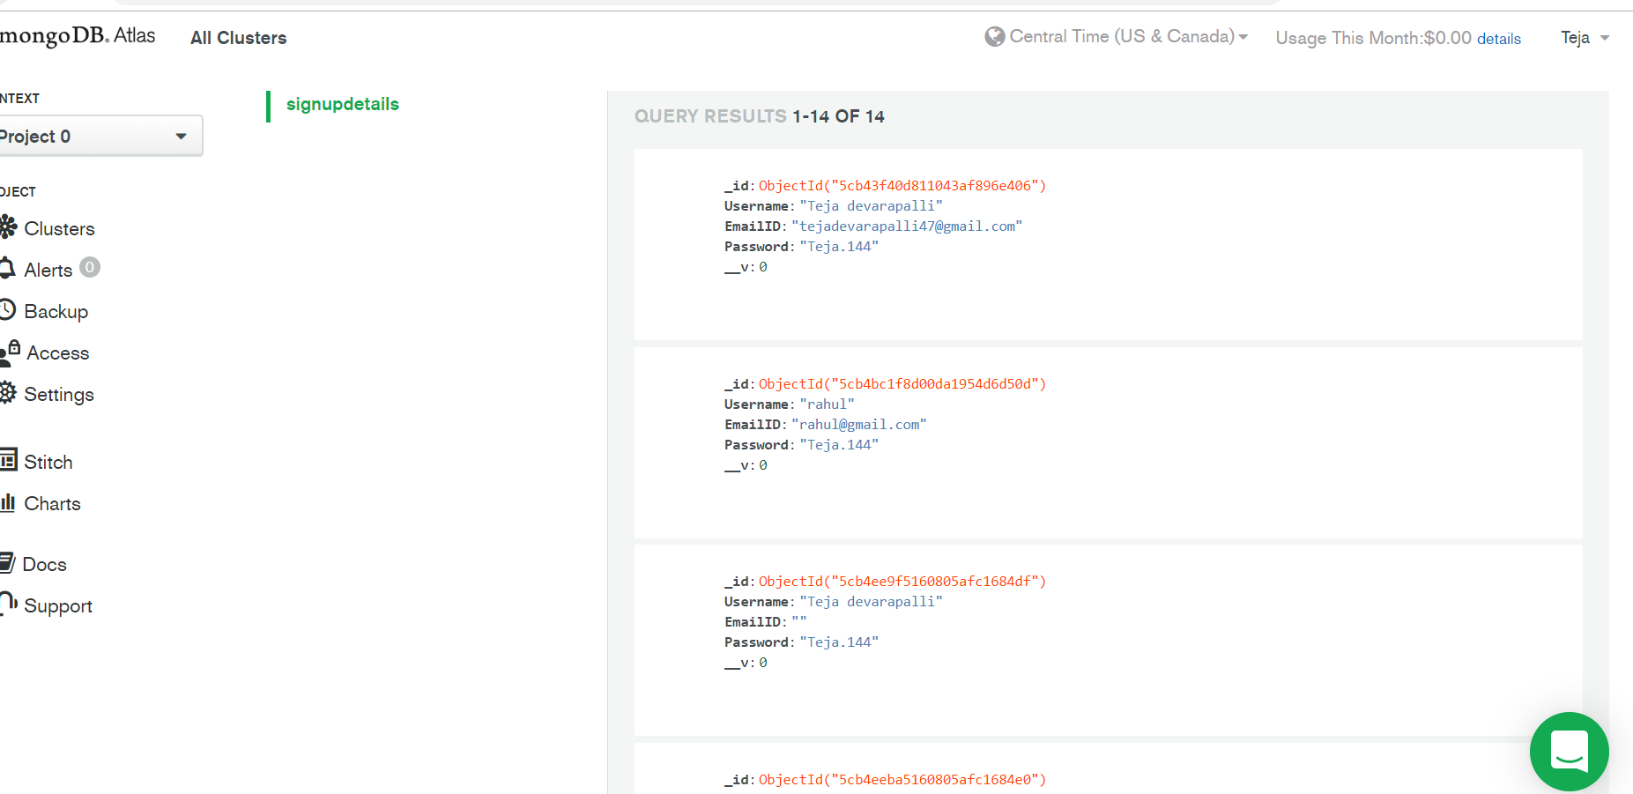
Sign UP Collection

Slide 11
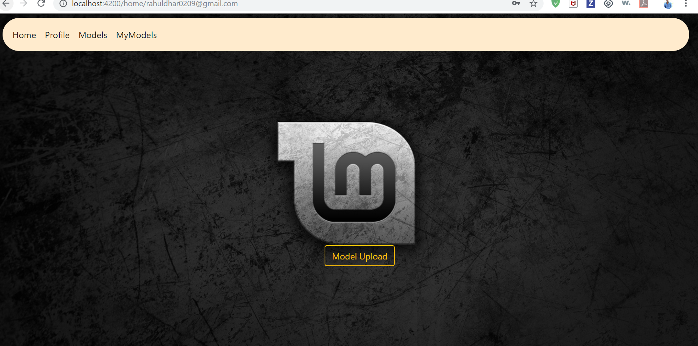
Home

Slide 12
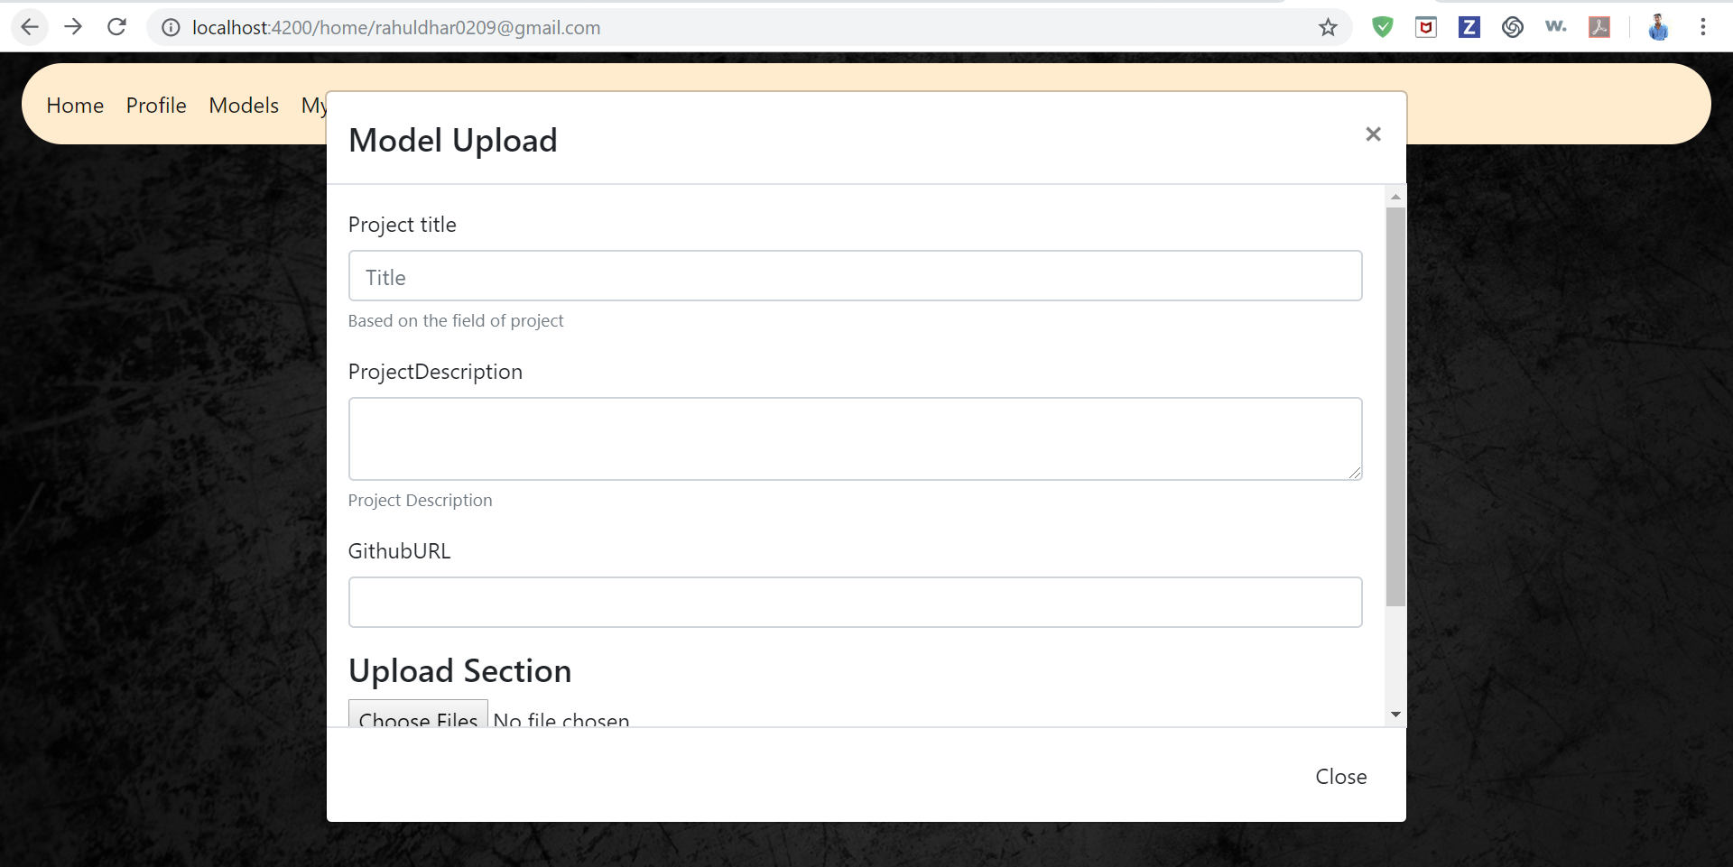
Upload

Slide 13
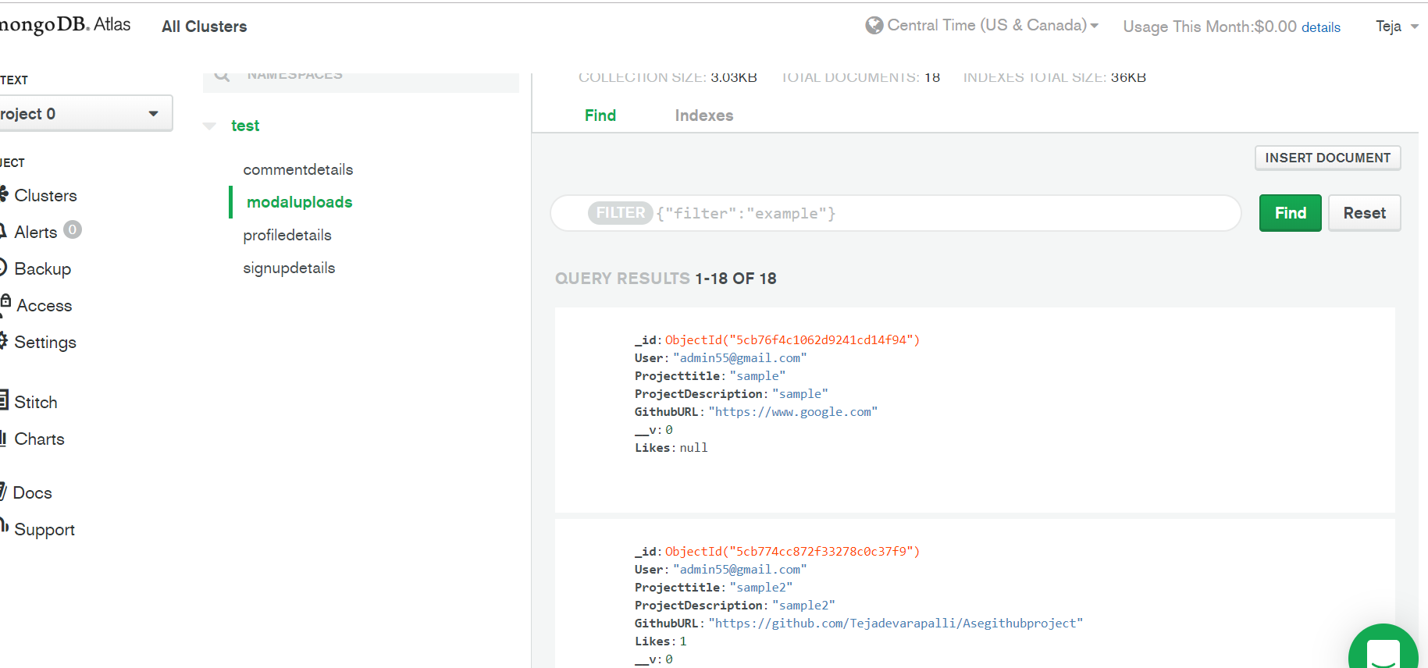
Model Upload Collection

Slide 14
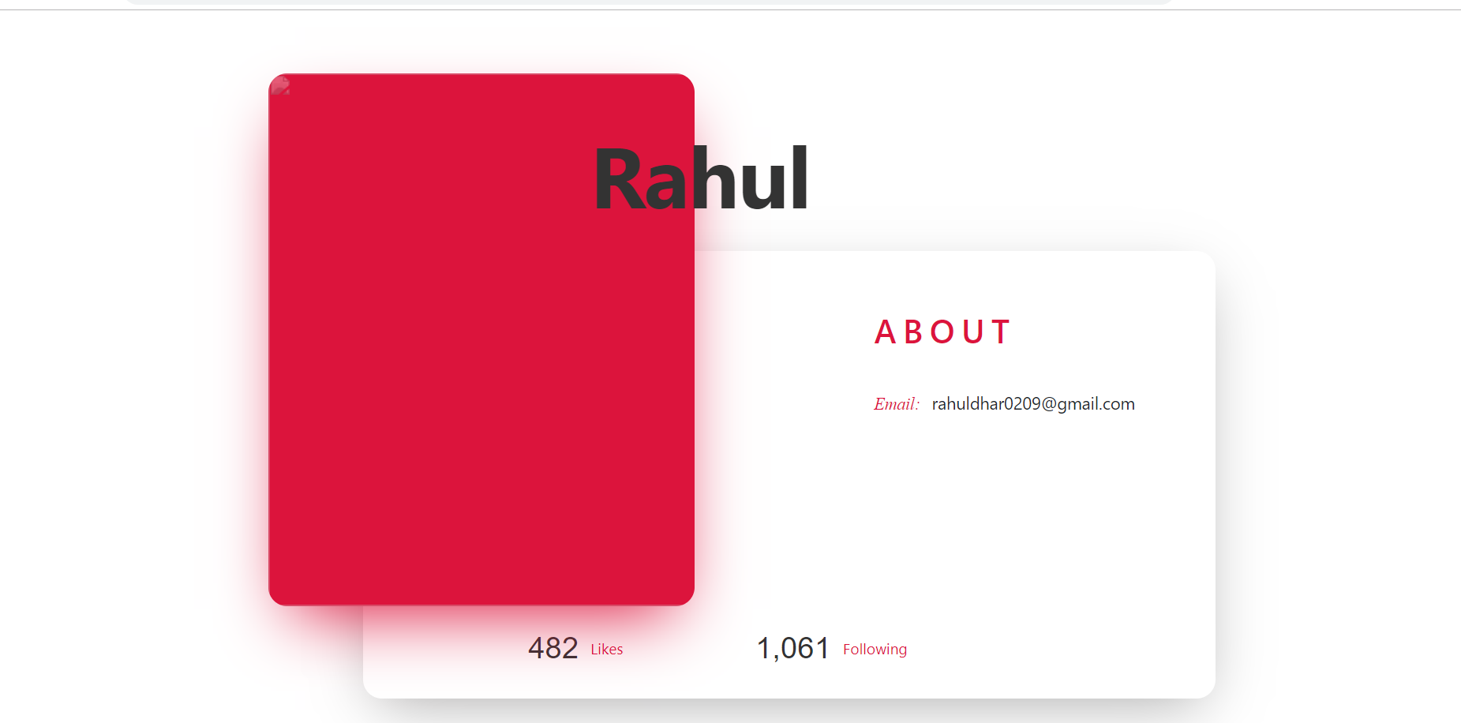
Profile

Slide 15
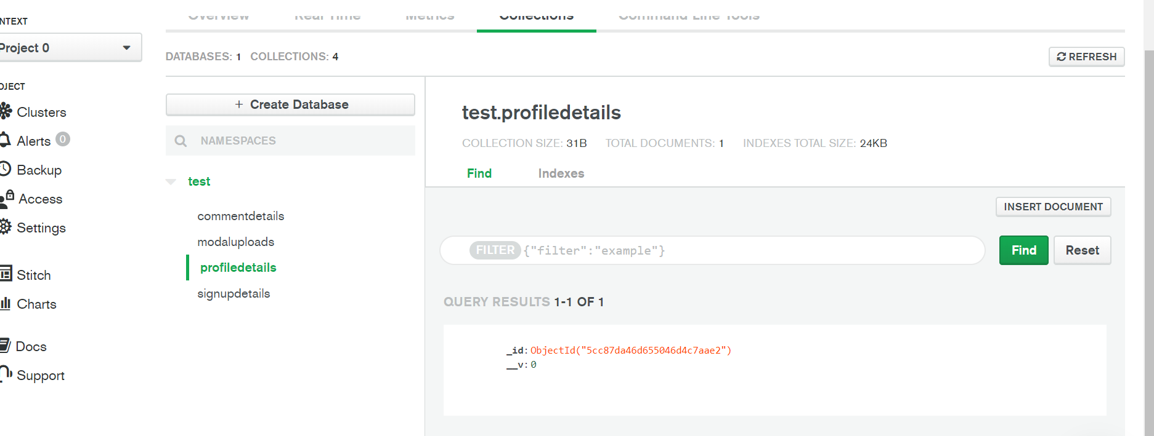
Profile Collections

Slide 16
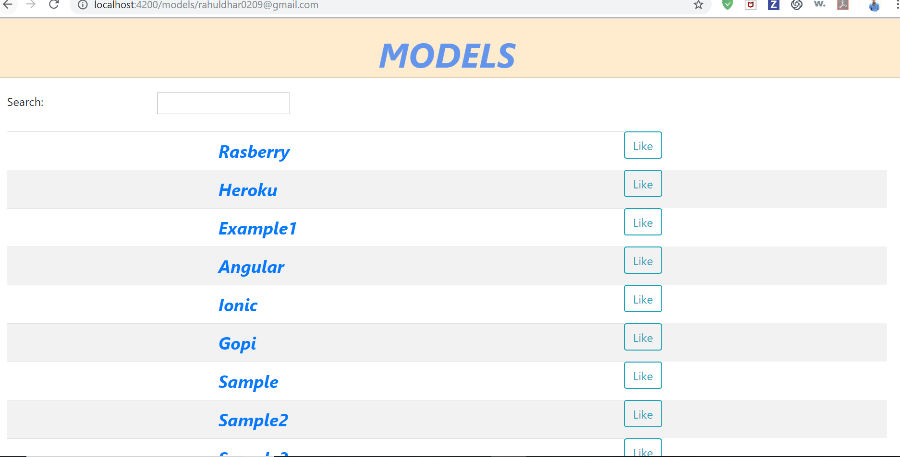
Models

Slide 17
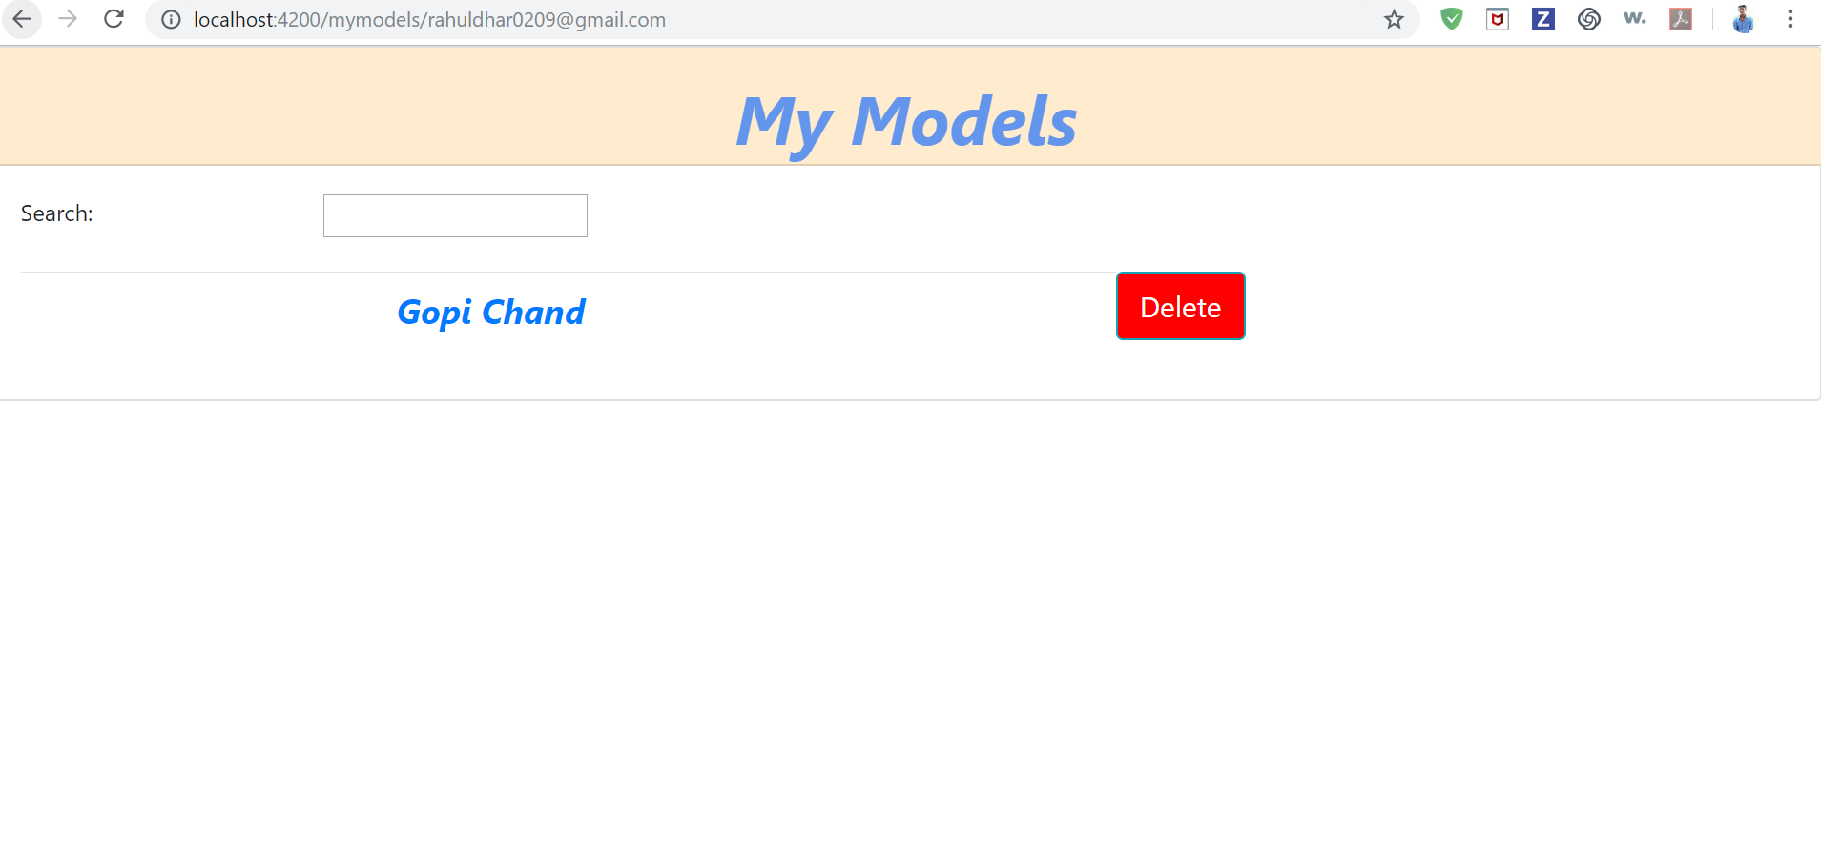
MyModels

Slide 18
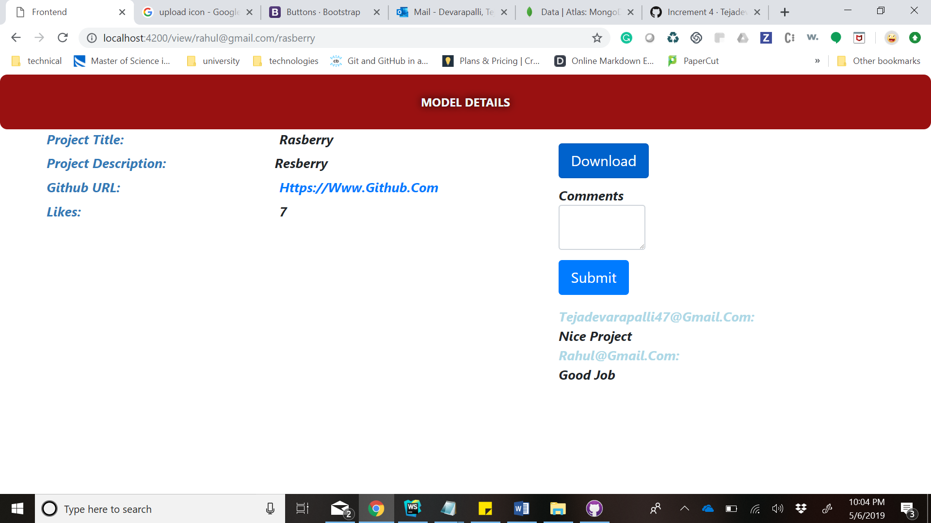
View Model

Slide 19
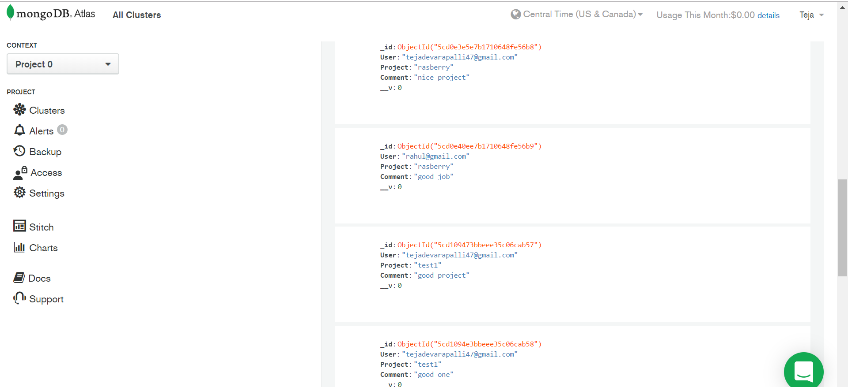
Comment collection

Slide 20
Testing
Manual Testing.
Regression Testing: This testing is done to make sure that new code changes should not have side effects on the existing functionalities. It ensures that the old code still works once the new code changes are done.

Slide 21
Deployment
https://ase-frontend.herokuapp.com
https://ase-backend.herokuapp.com/

Slide 22
Thank you

